Slide 1
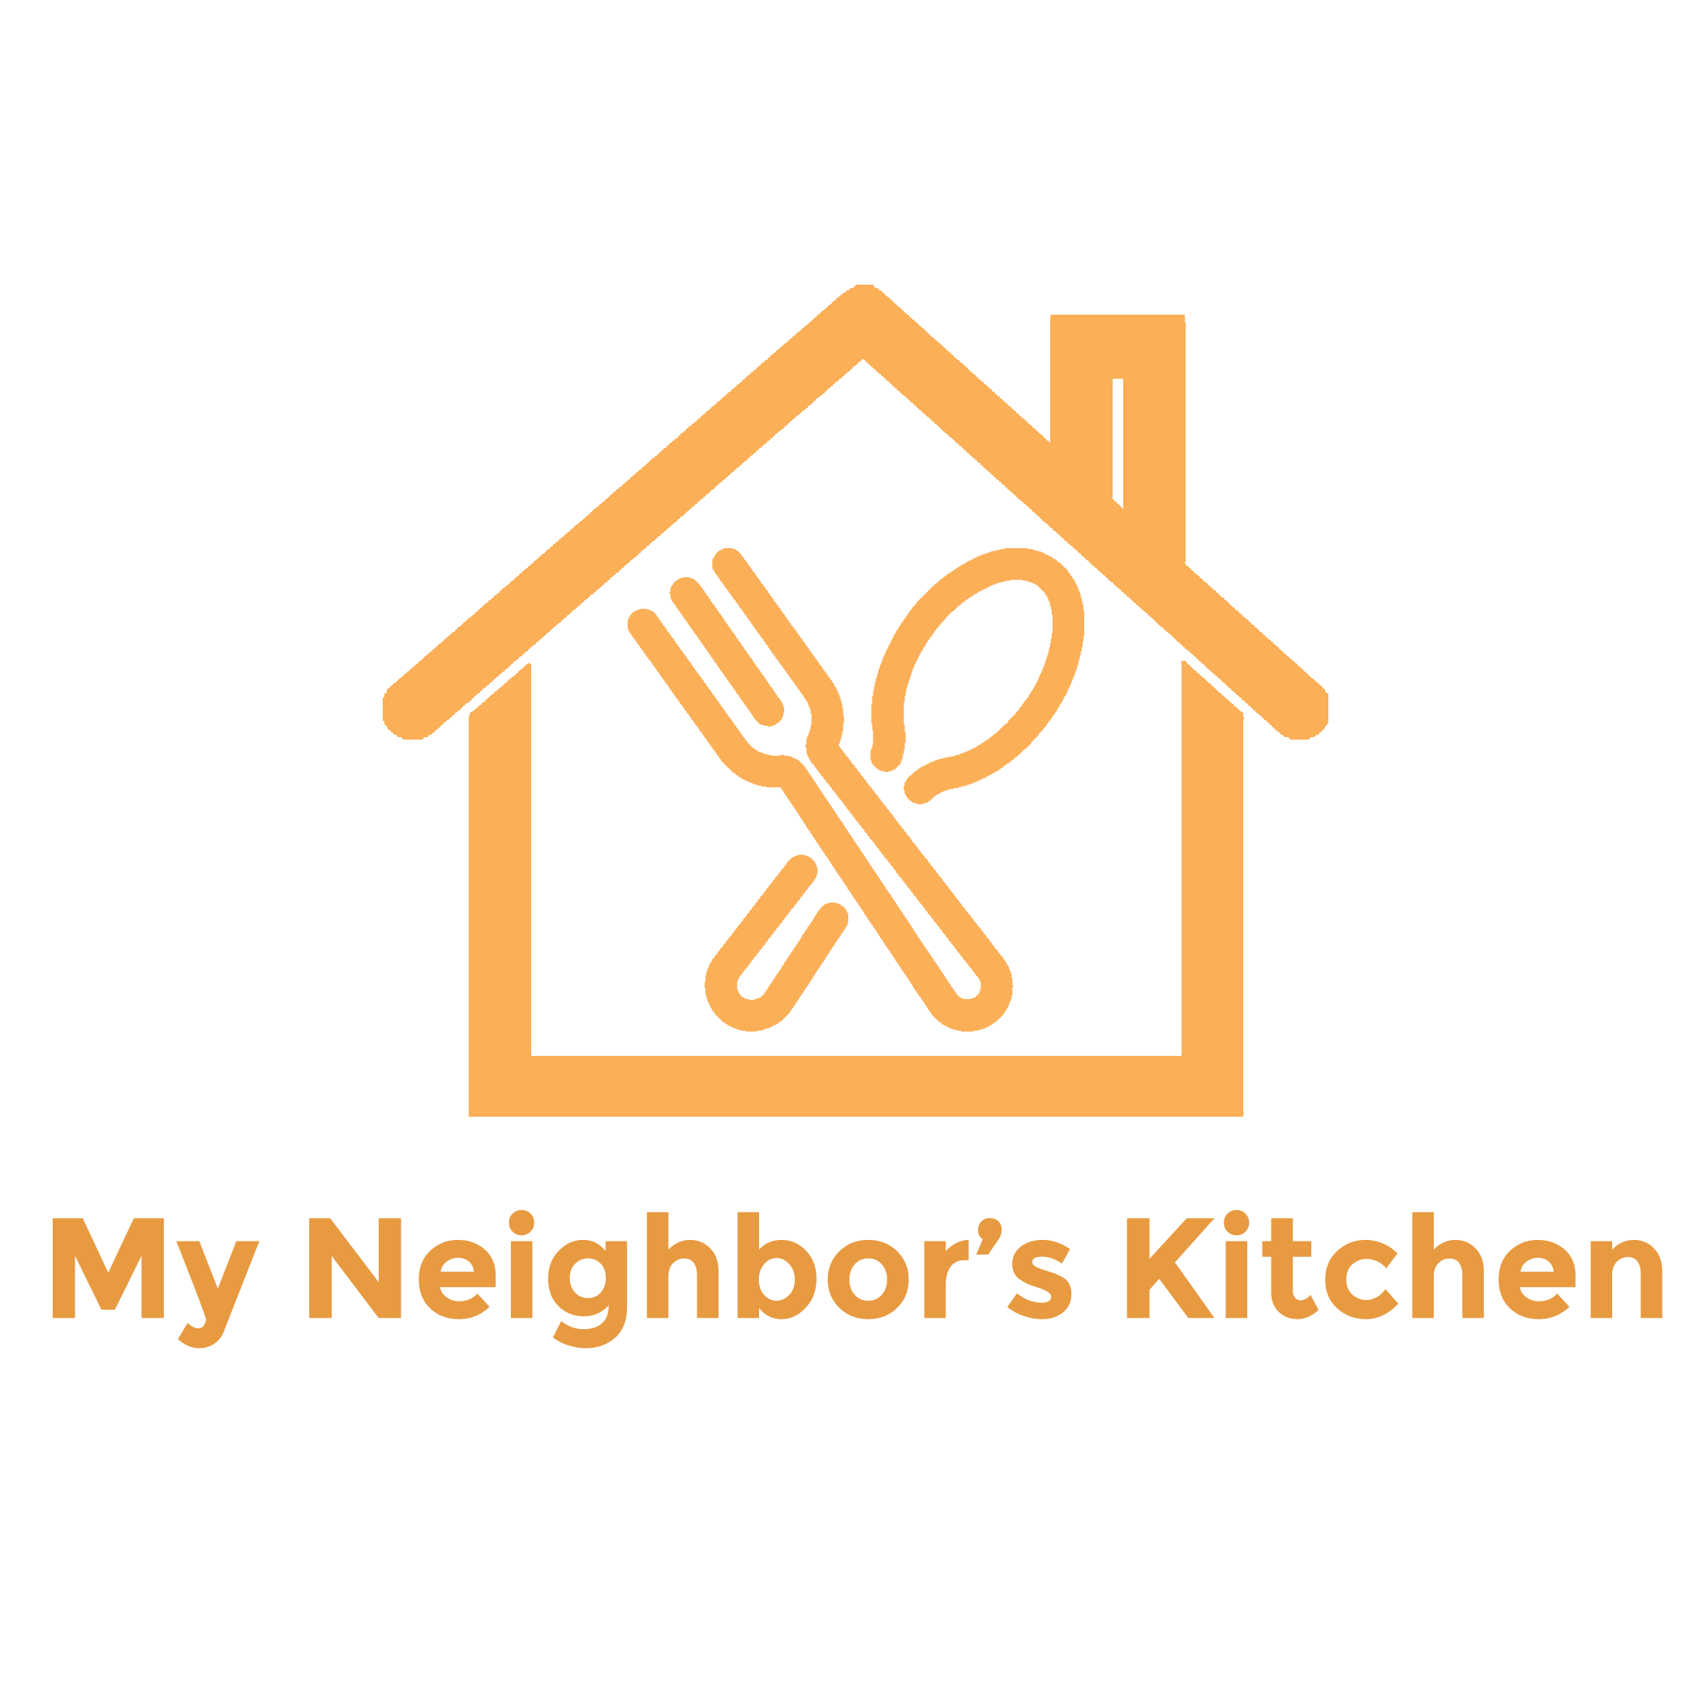
Medium-Fi Prototype

Slide 2
end food waste. locally.
40% of all food grown in America is wasted. Meanwhile, 1 in 7 Americans are food insecure. My Neighbor’s Kitchen tackles food waste at the source: local communities. Instead of throwing out excess food, make it available to hungry people around you. Don’t go hungry when you can leverage the resource you have just a few feet away - the kitchen next door.

Slide 3
Outline
Tasks
Revised Design
Major Changes
New Task Flows
Prototype Overview

Slide 4
Outline
Tasks
Revised Design
Major Changes
New Task Flows
Prototype Overview

Slide 5
Tasks [same as low-fi]
Simple: Post that you have leftover food.
Medium: Find a leftover meal nearby & pick it up.
Complex: Create a food challenge competition to see who can donate the most meals & send it to your block.

Slide 6
Outline
Tasks
Revised Design
Major Changes
New Task Flows
Prototype Overview

Slide 7
Overview of Design Changes
Stronger and clearer line of communication between poster and receiver
More details about the quality of the food
Simplifying the process of creating a challenge
Reminders about picking food up in the allotted time limit.
Removed non-core features (food runs)

Slide 8
Outline
Tasks
Revised Design
Major Changes
New Task Flows
Prototype Overview
Notes:
Walkthrough of major changes in the UI for each task

Slide 9
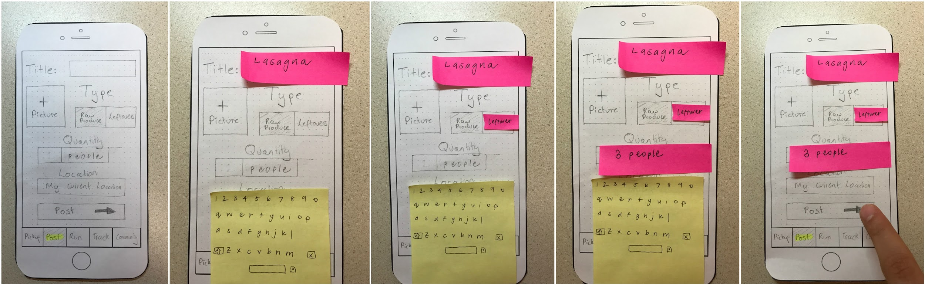
Task 1: Post Leftover Food
BEFORE

Slide 10
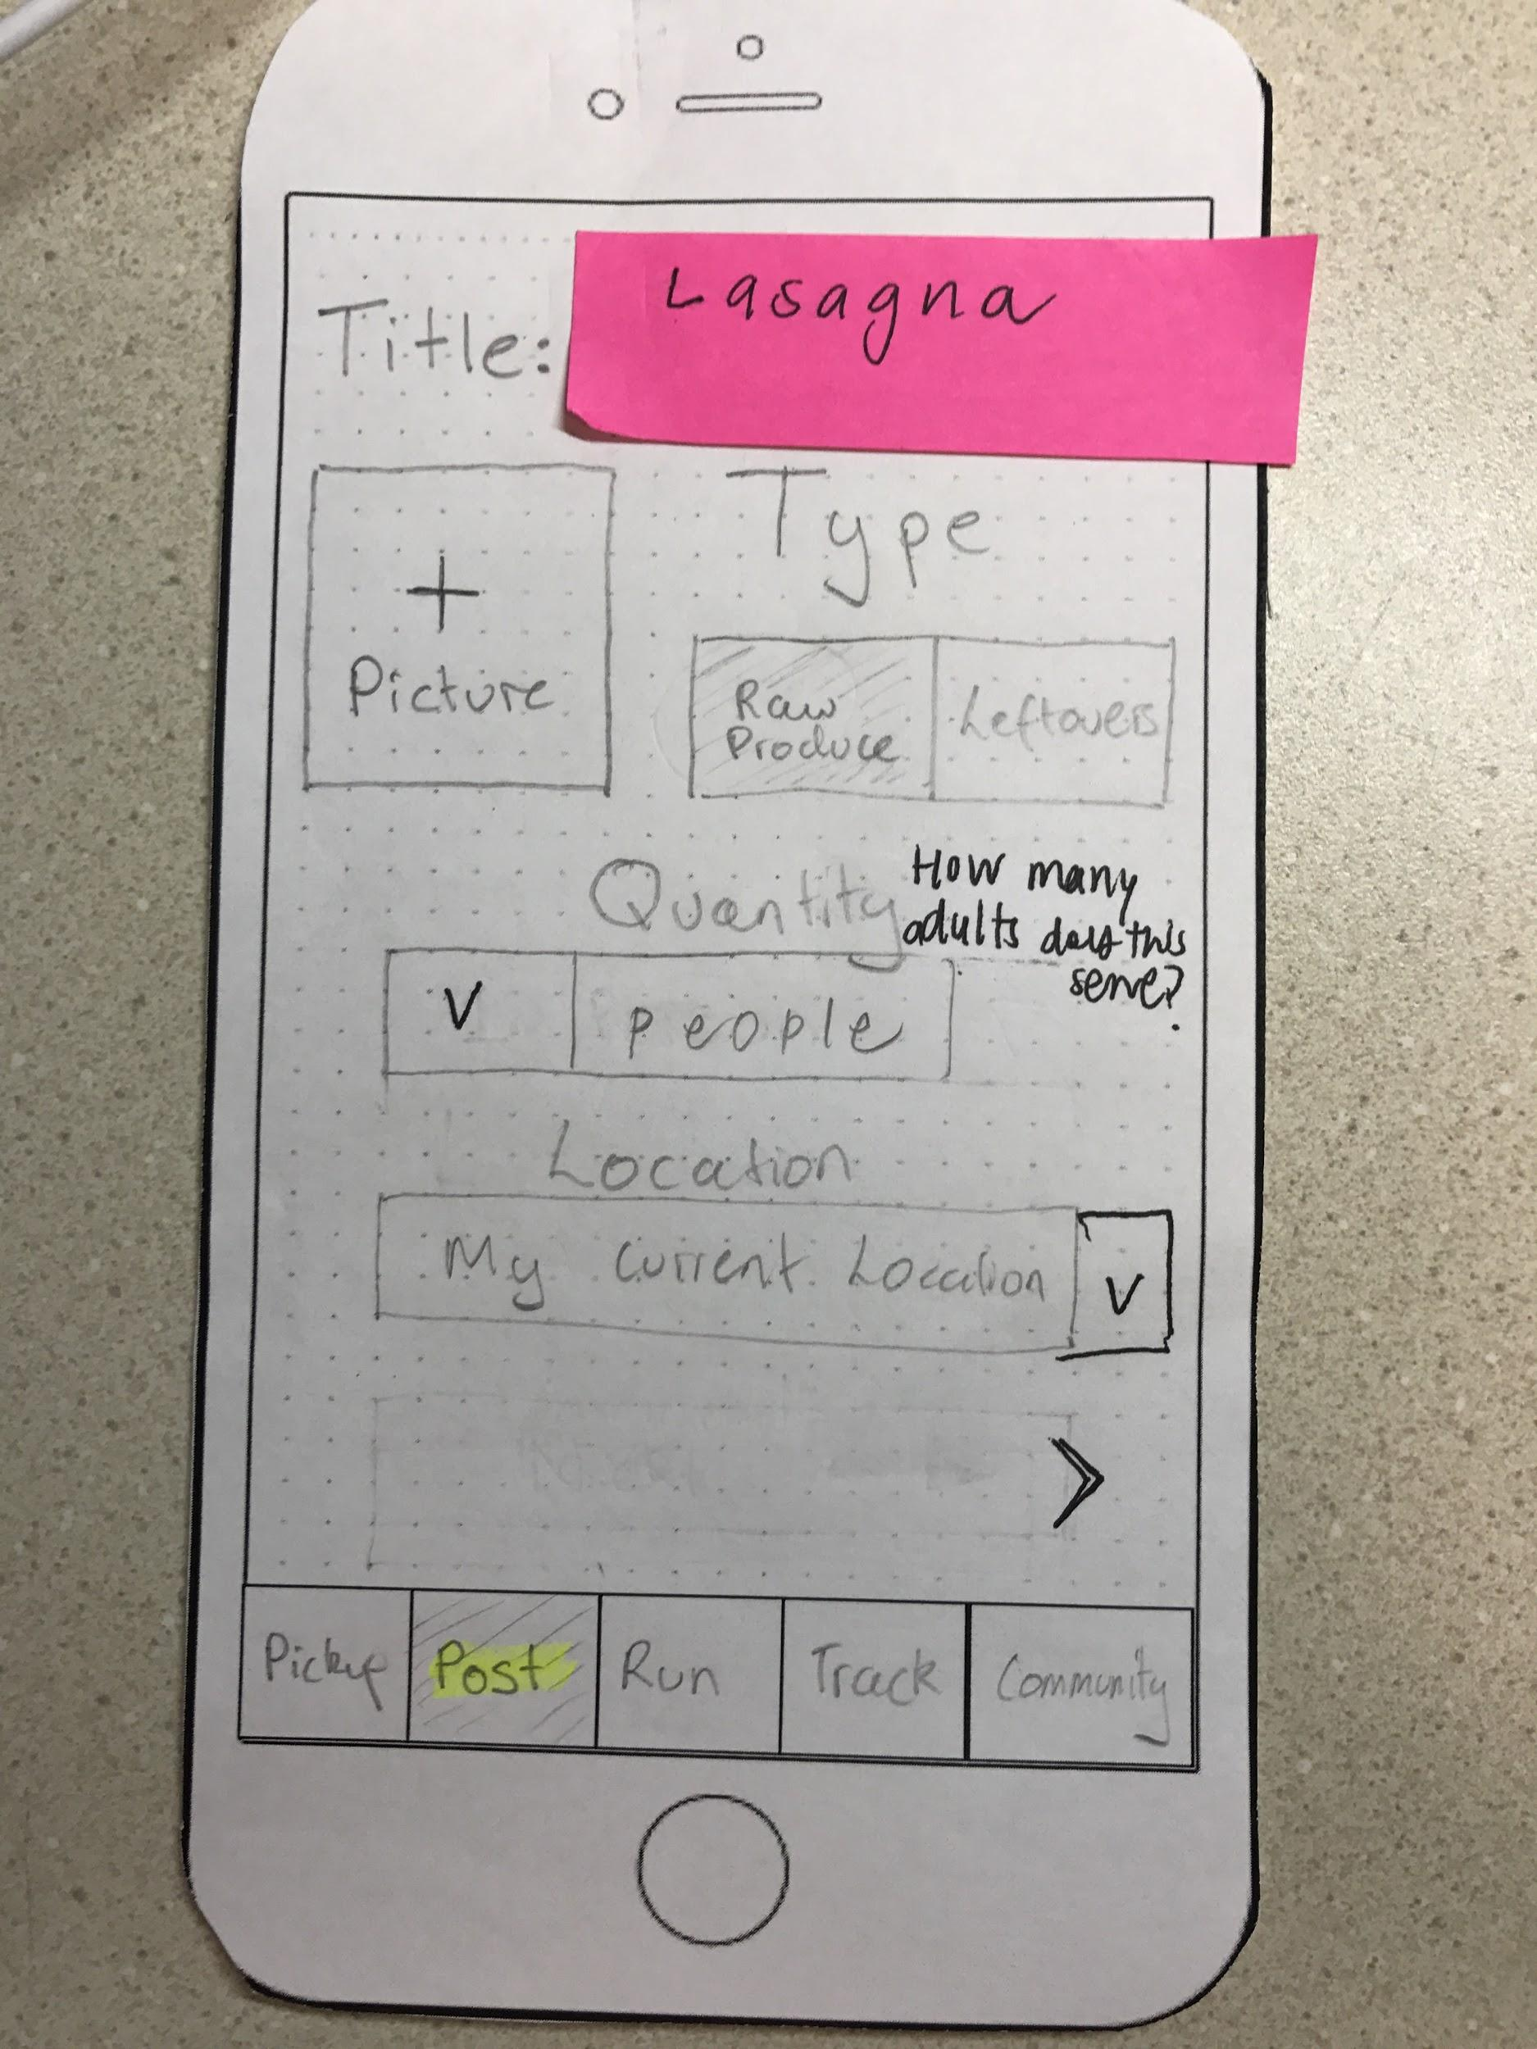
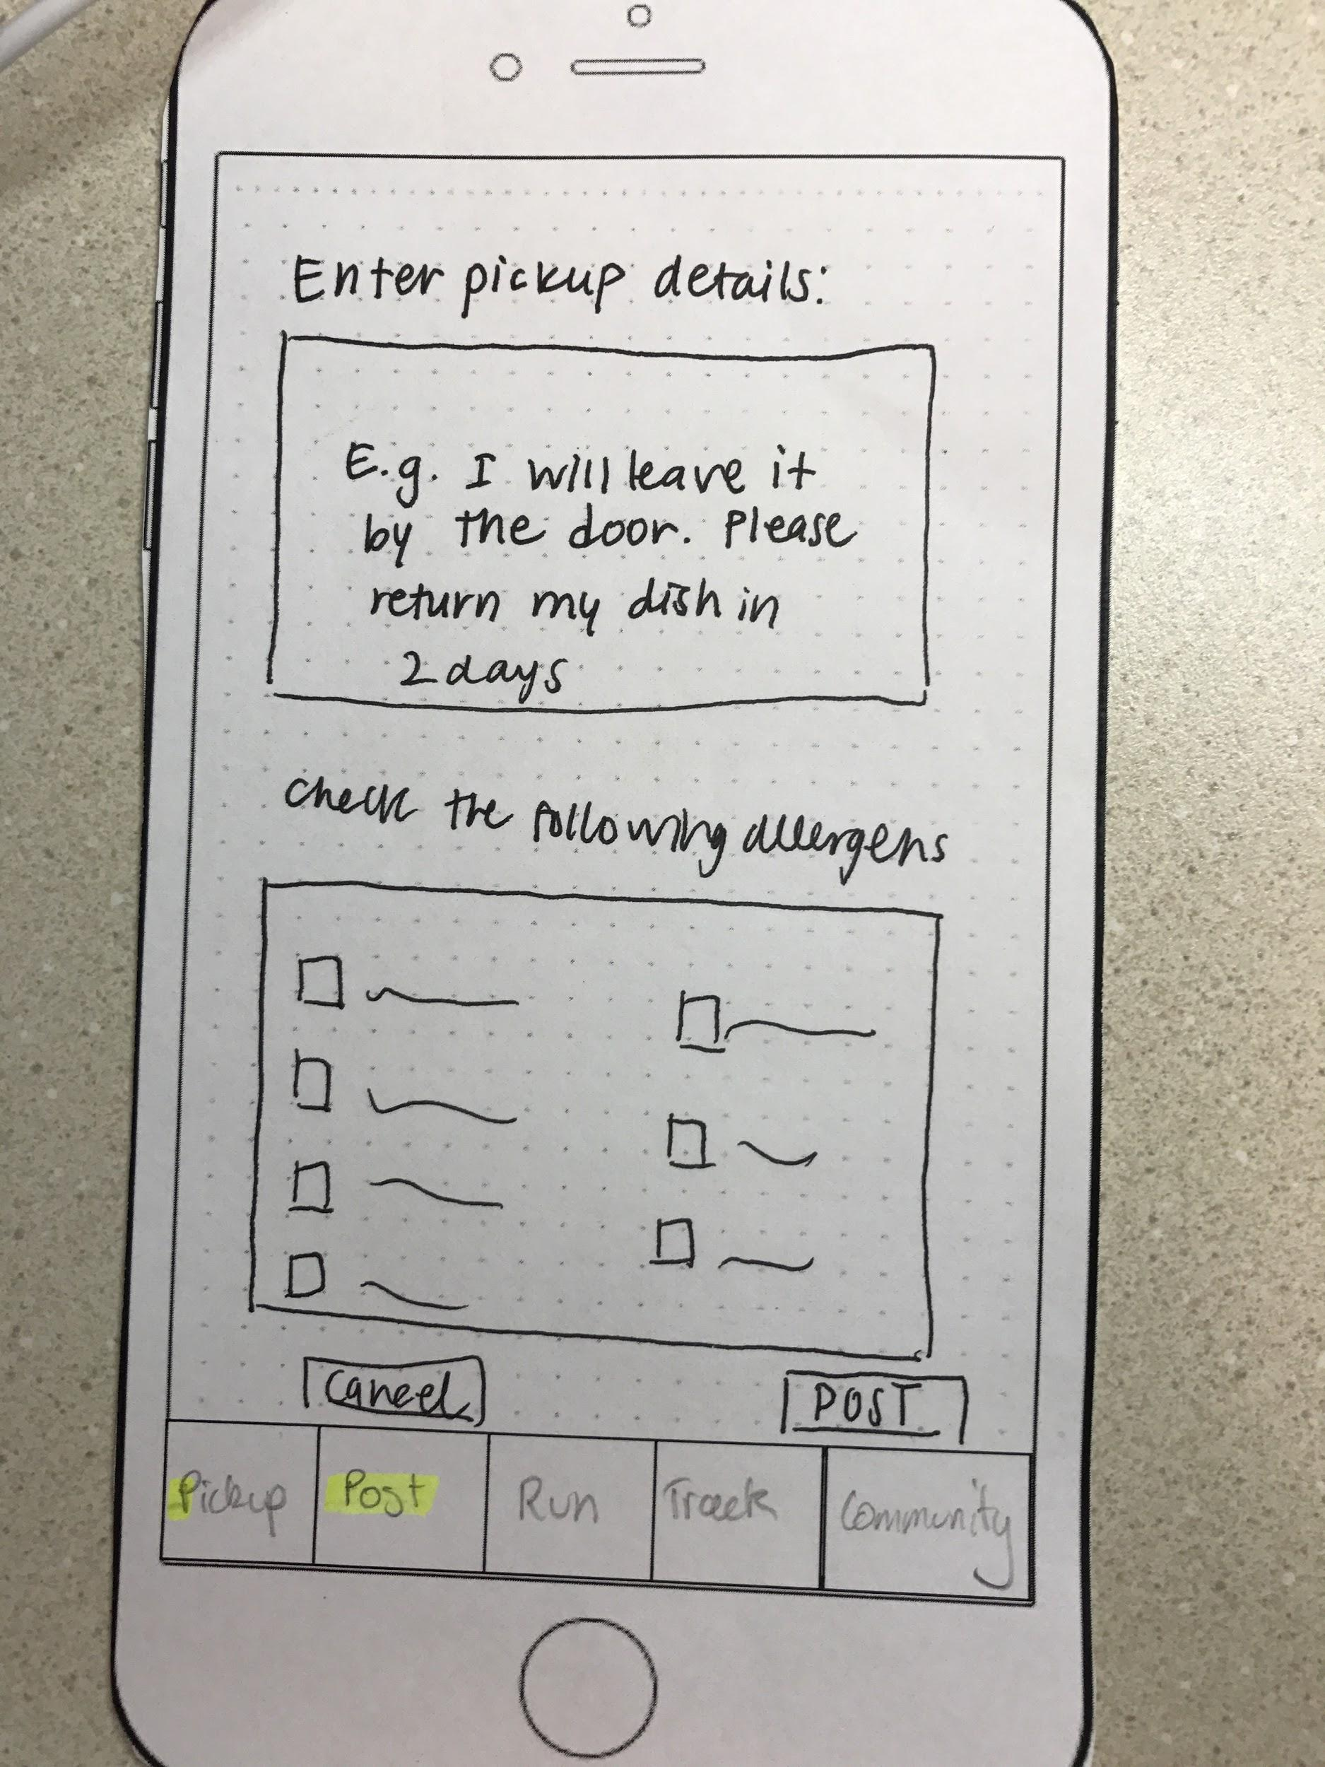
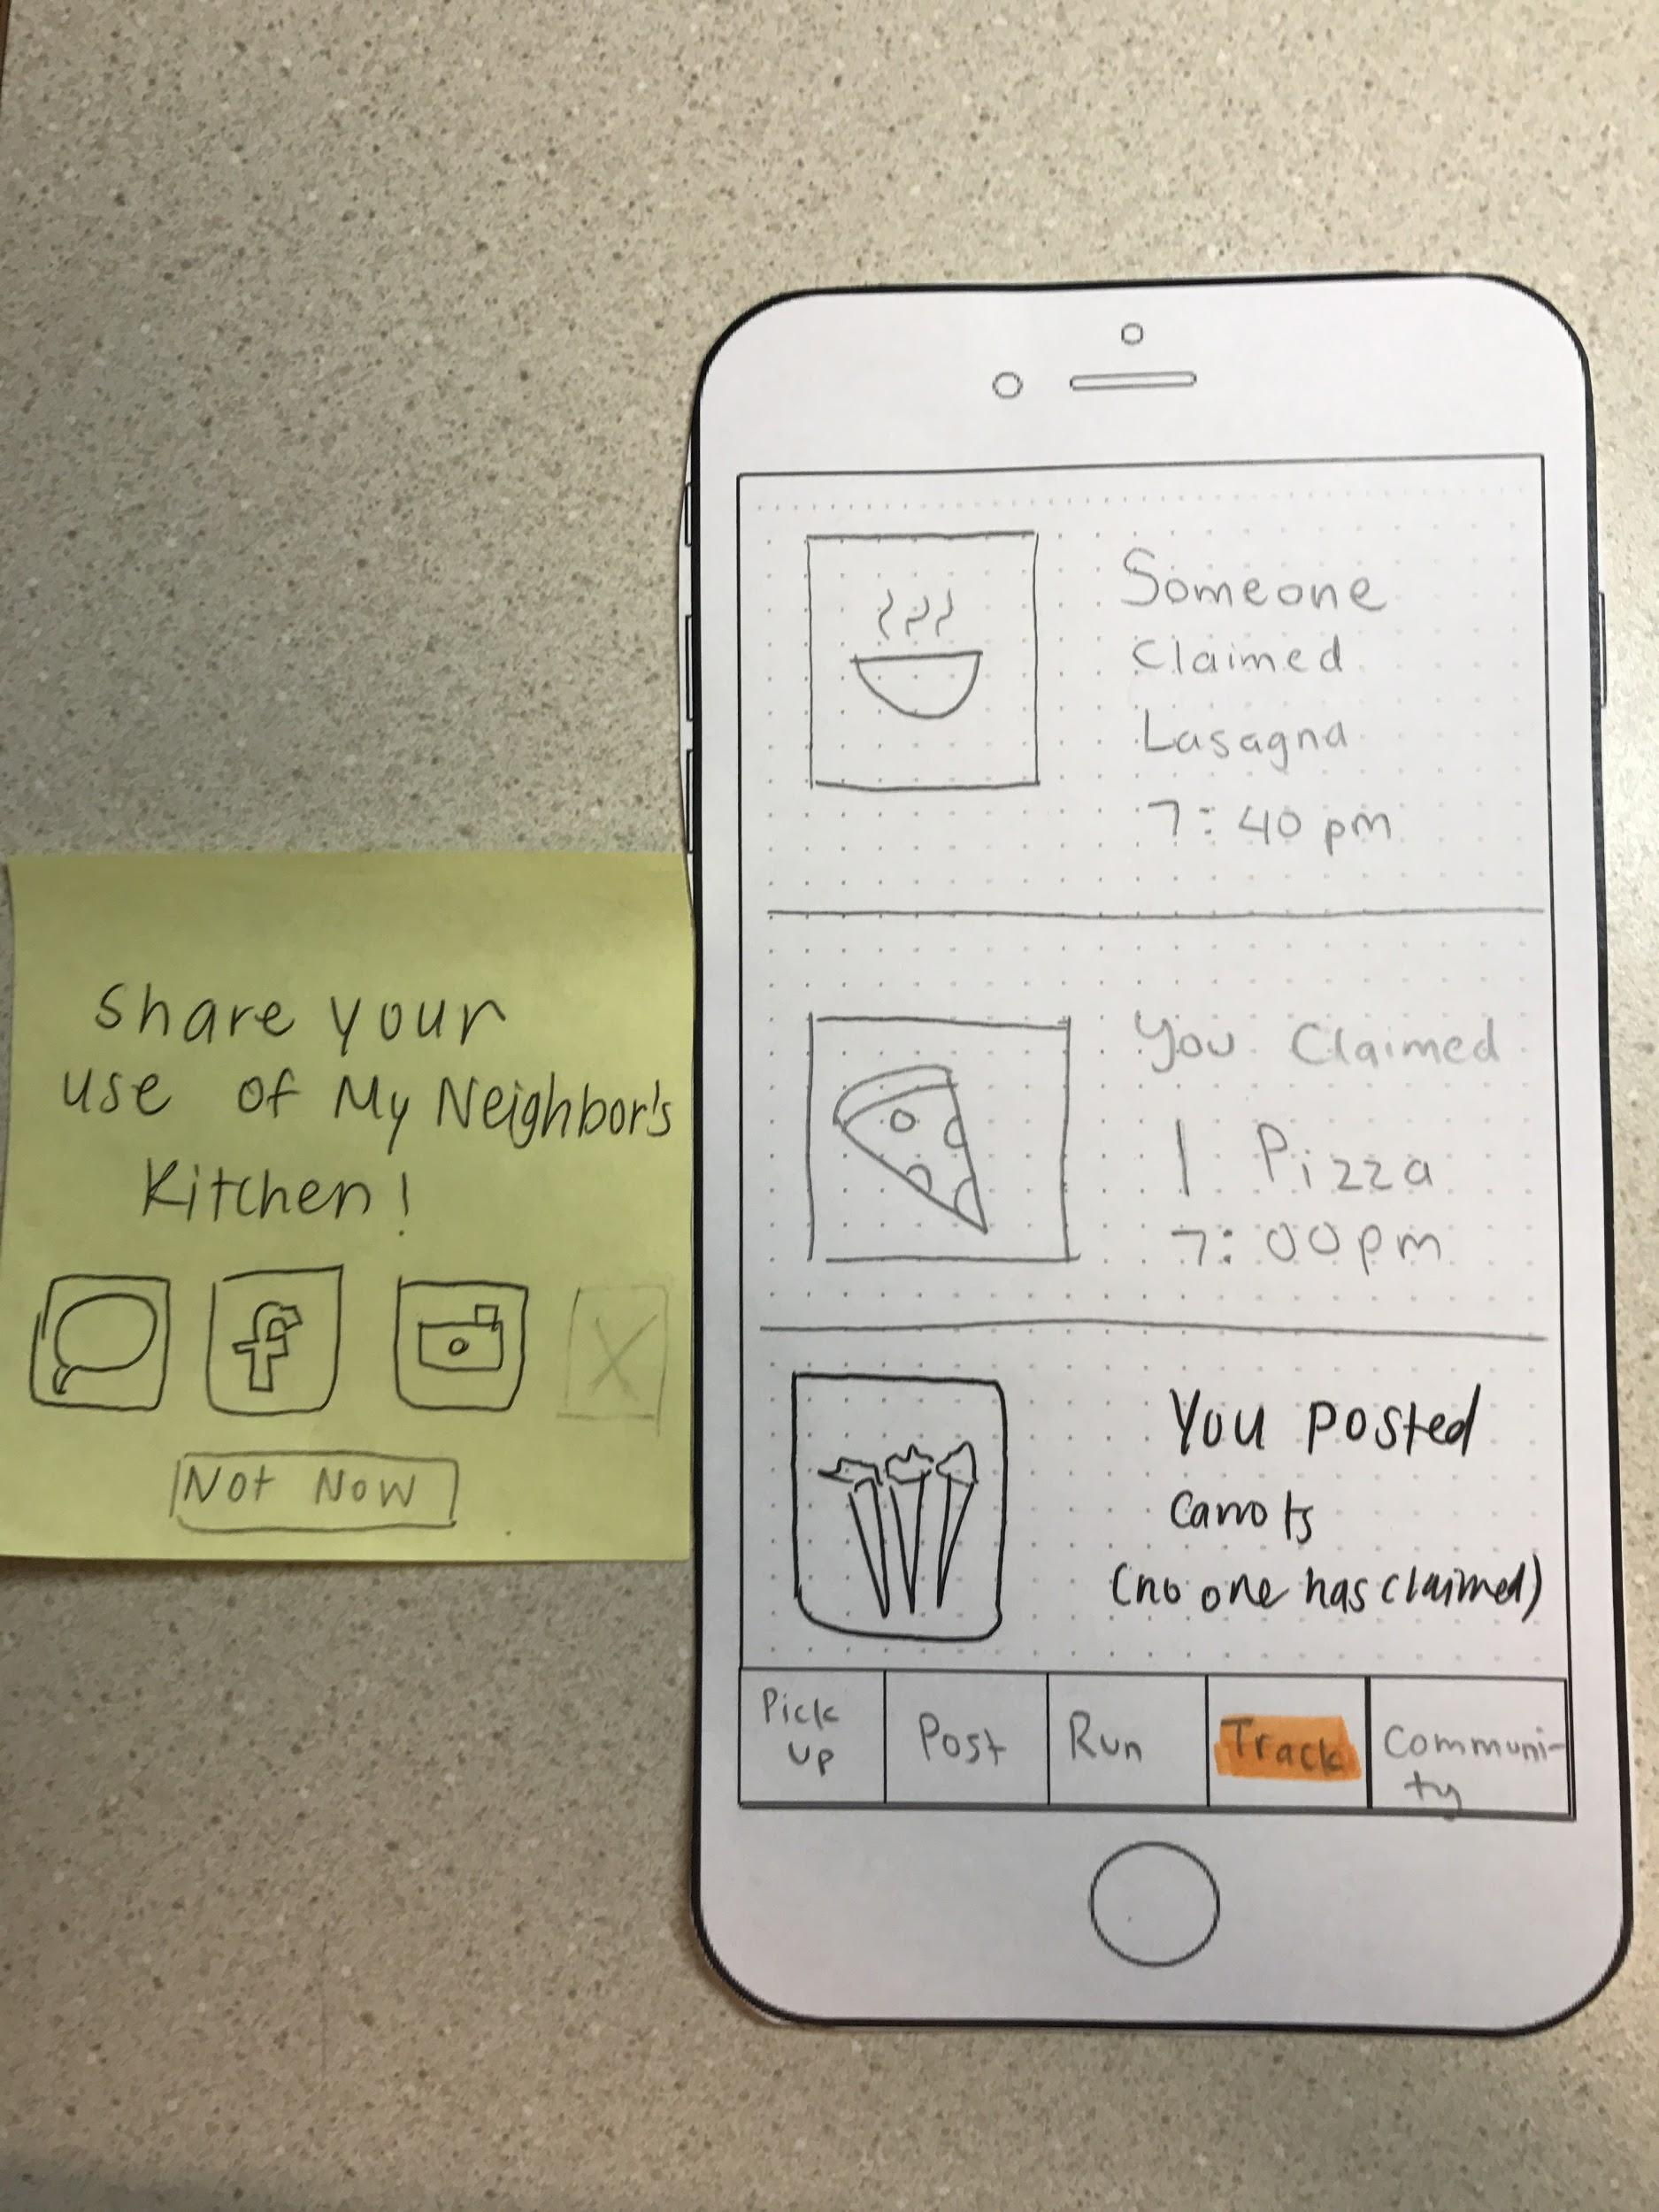
Task 1: Post Leftover Food
AFTER

Slide 11
Rationale
Task 1: Post Leftover Food
Clarifying descriptor next to quantity removes the serving size confusion
Drop down menu next to default location allows alternate entries
New fields to enter pickup details allow the user more control
Example entry helps us establish the norm
Allergens checkboxes provide level of assurance about food quality

Slide 12
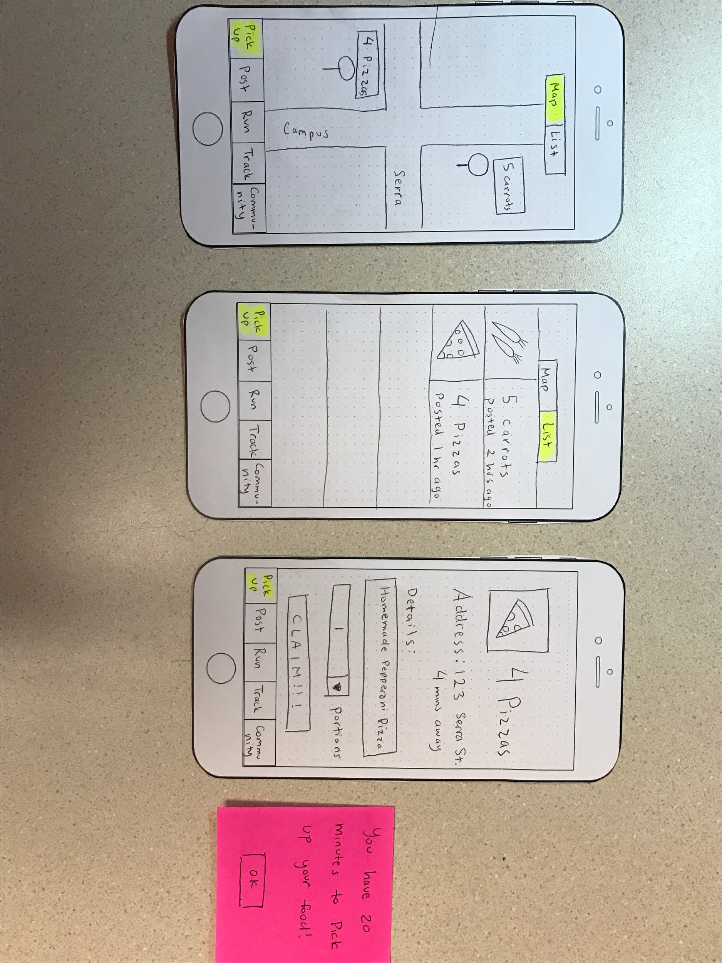
Task 2: Pickup Leftover Food
BEFORE

Slide 13
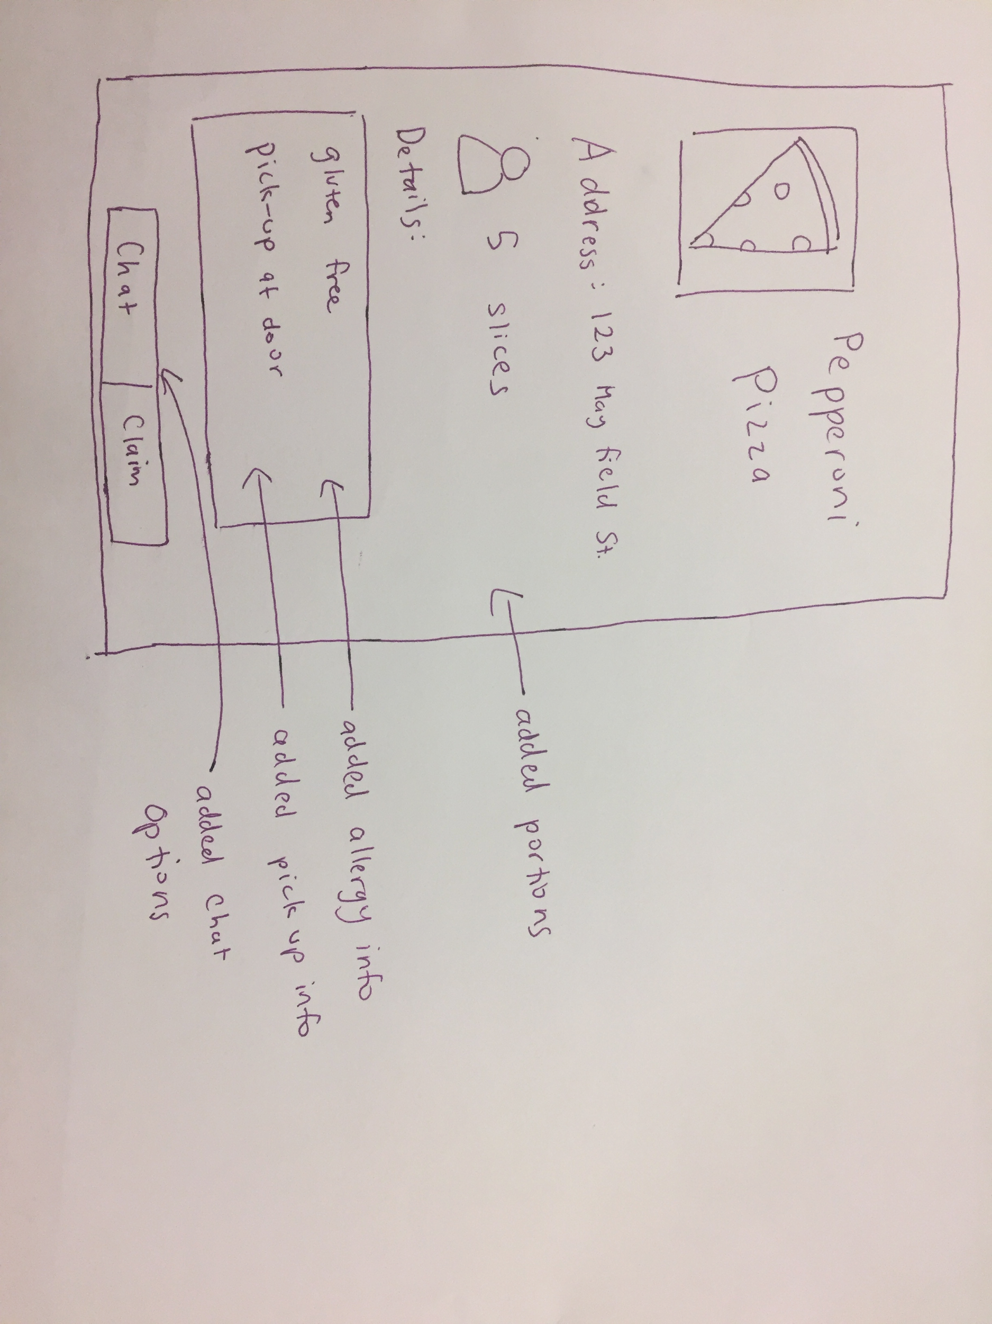
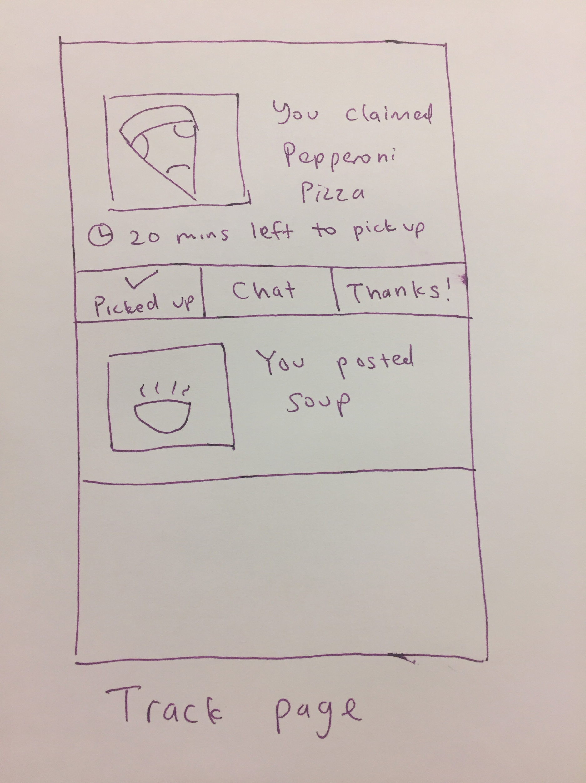
Task 2: Pickup Leftover Food
AFTER

Slide 14
Rationale
Task 2: Pickup Leftover Food
All relevant information in text form allows for quick understanding of portion size/allergens/intended interaction
Chat tab provides real time clarification + update opportunities
Redirection to the “Track” page displays time limits to pickup food
Track page functions as a home screen/scrollable feed

Slide 15
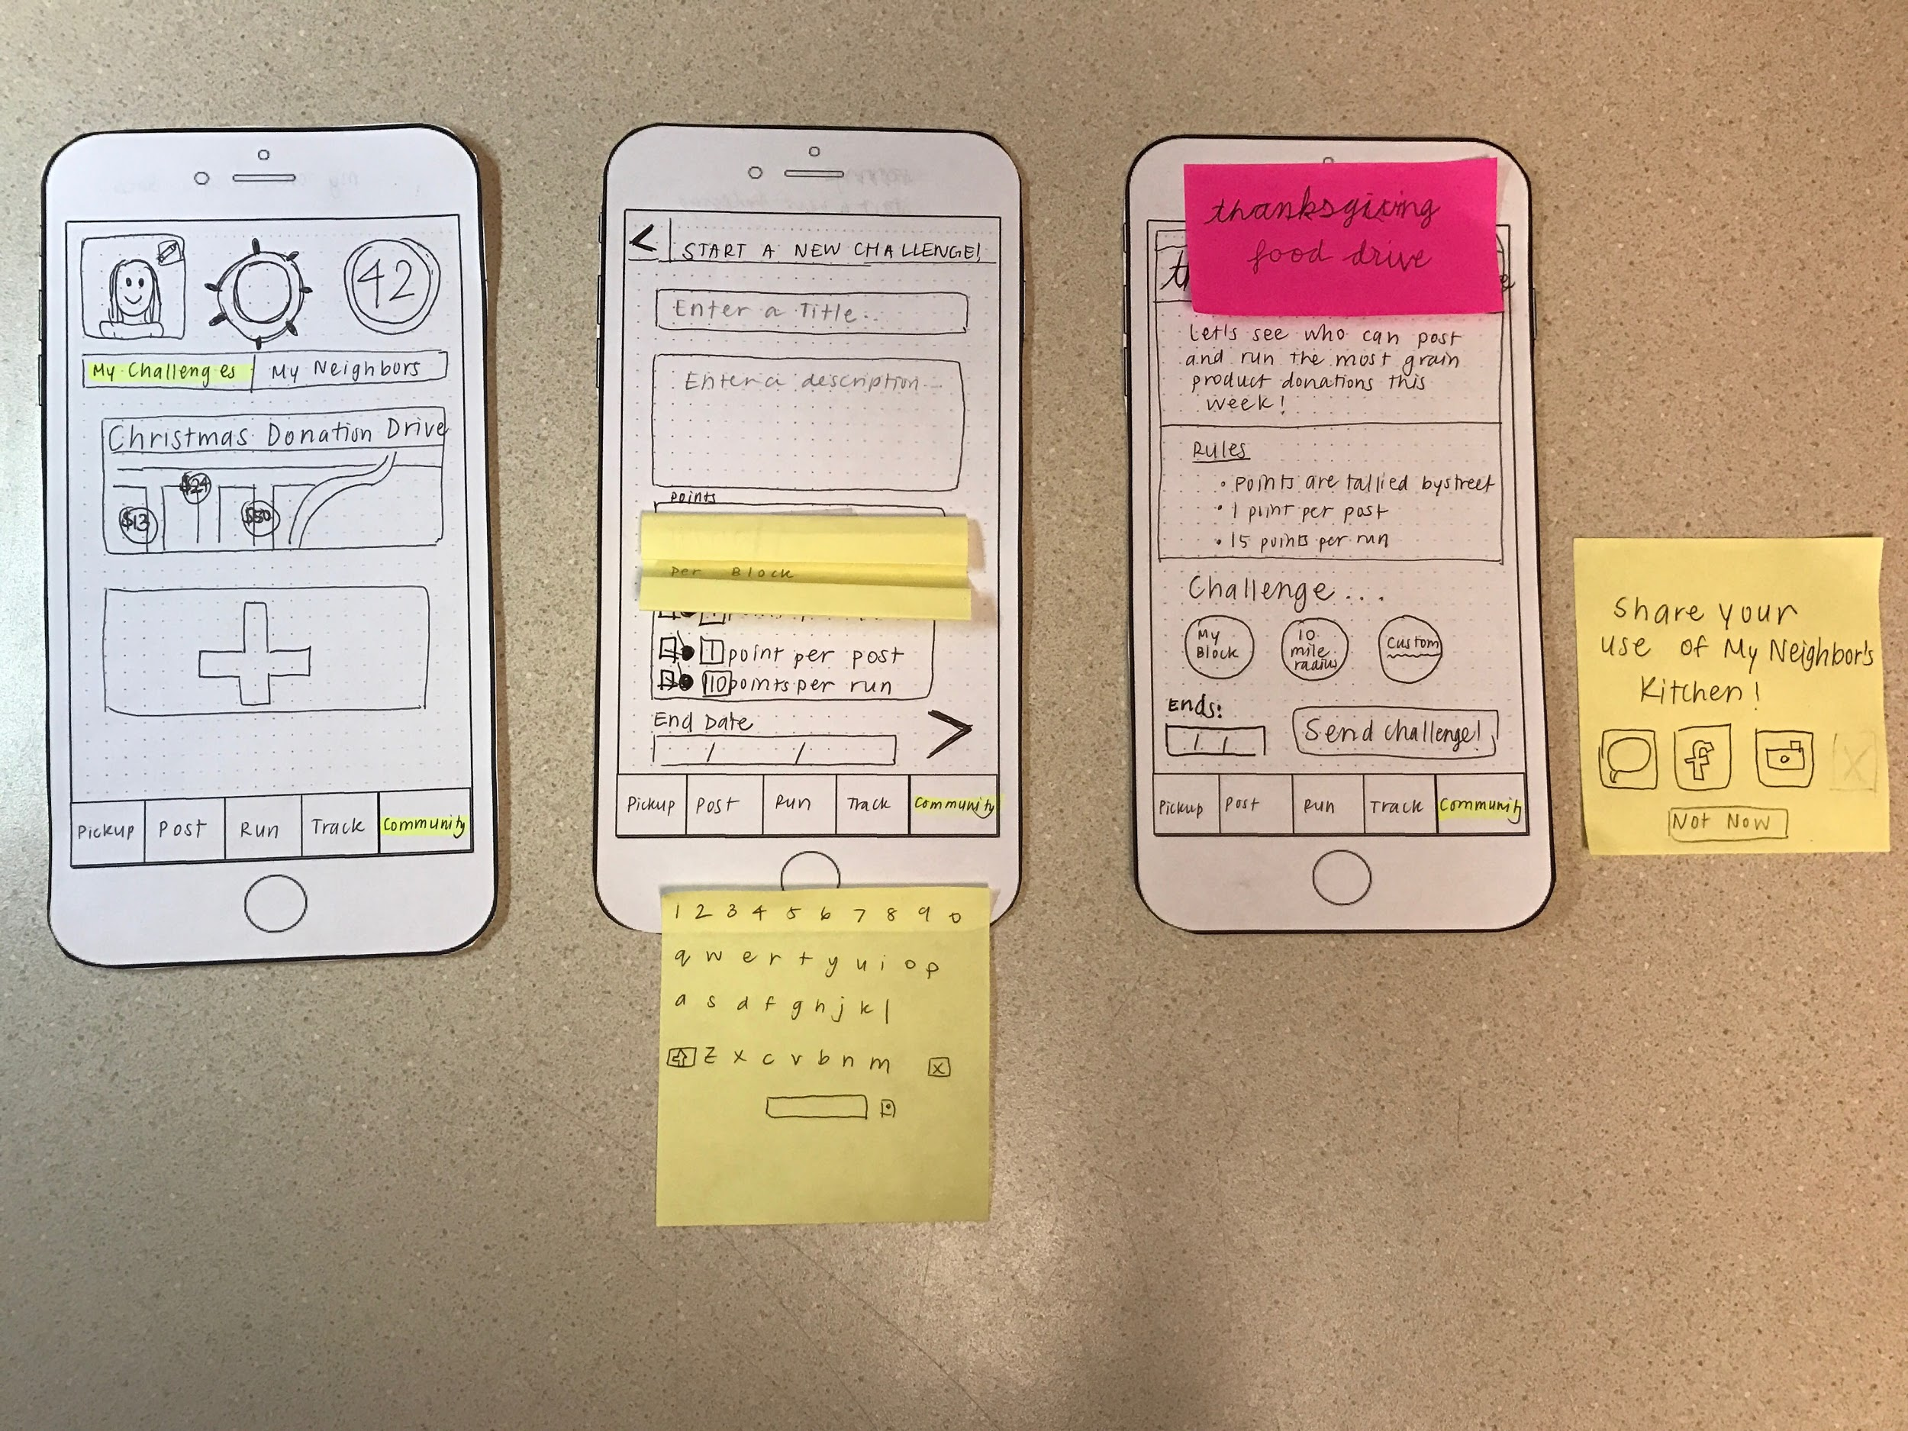
Task 3: Start a Community Challenge
BEFORE

Slide 16
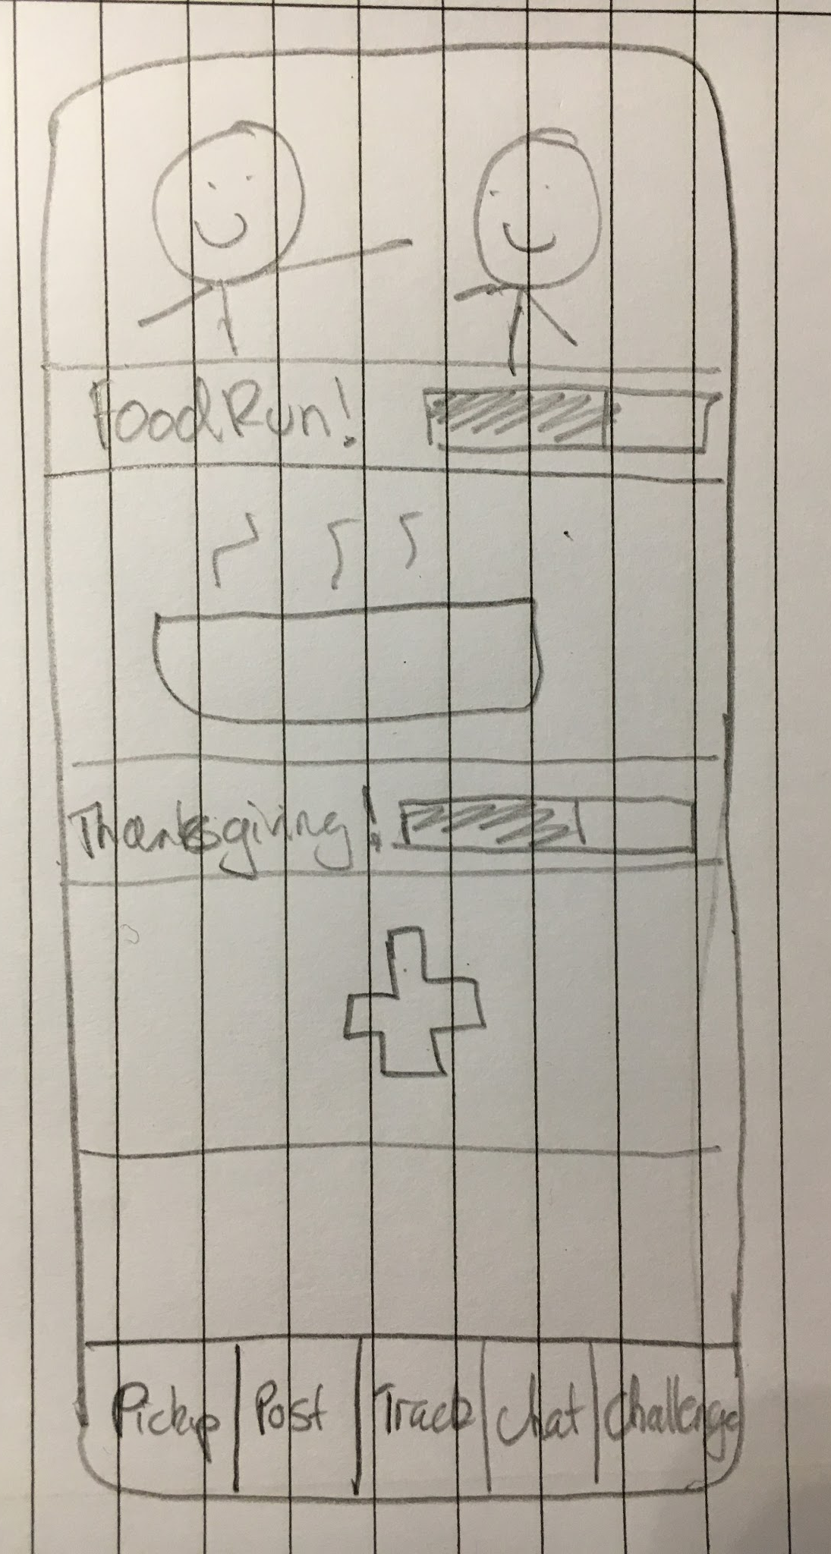
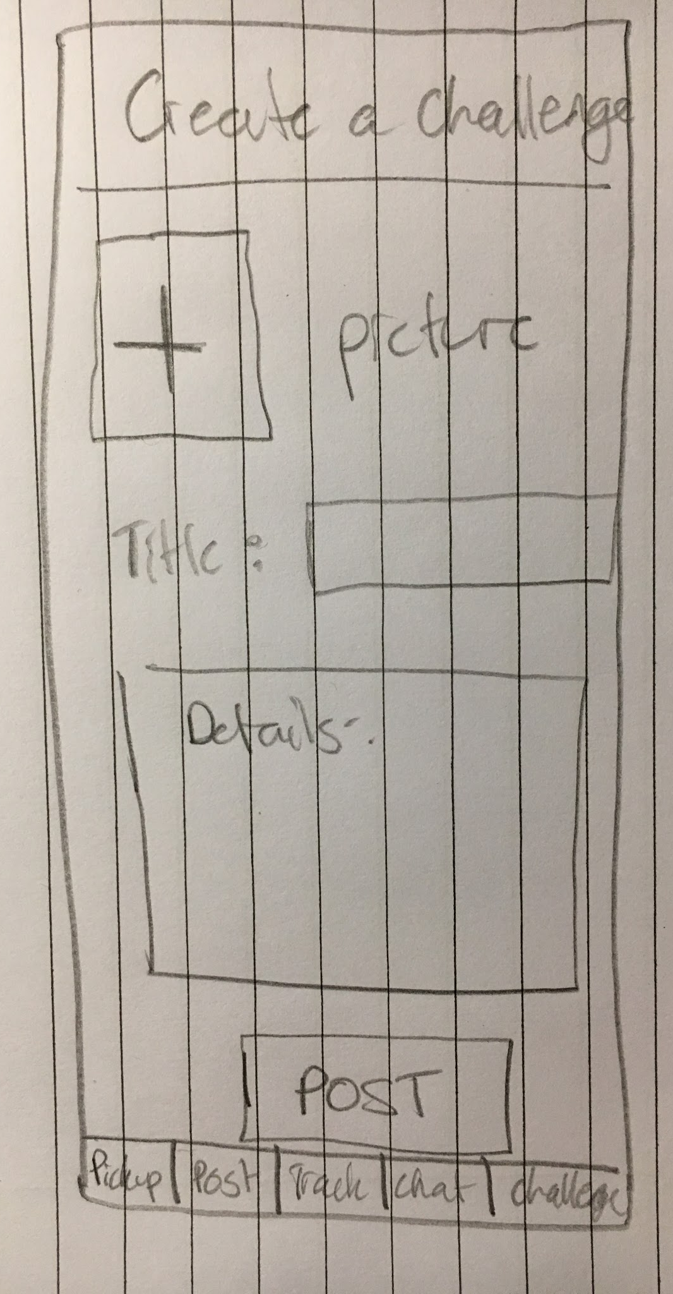
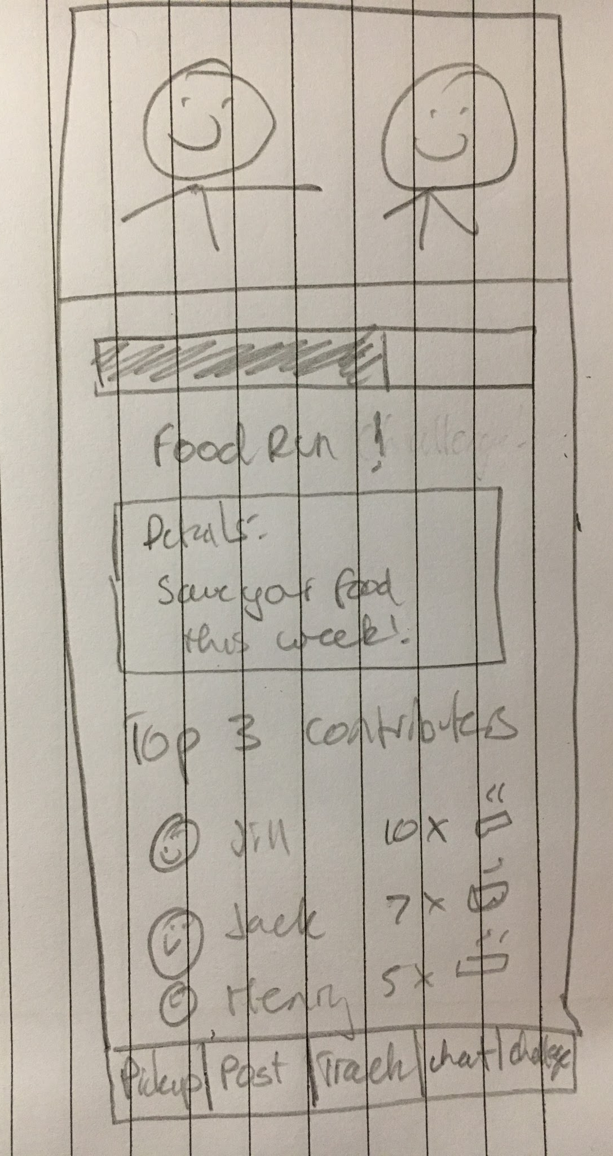
Task 3: Start a Community Challenge
AFTER
Simplified post options
Created event page display

Slide 17
Rationale
Task 3:
Start a Community Challenge
Simplify ‘confusing’ community aspect of app
Communicate more clearly the ‘function’ associated with the community tab (renamed)
‘Community’ -> ‘Challenges’
Simply challenges:
Open to everyone
No ‘point system’, no ‘money’. Now just simply counting numbers of meals picked up and posted.
More like events

Slide 18
Outline
Tasks
Revised Design
Major Changes
New Task Flows
Prototype Overview
Notes:
Walkthrough of major changes in the UI for each task

Slide 19
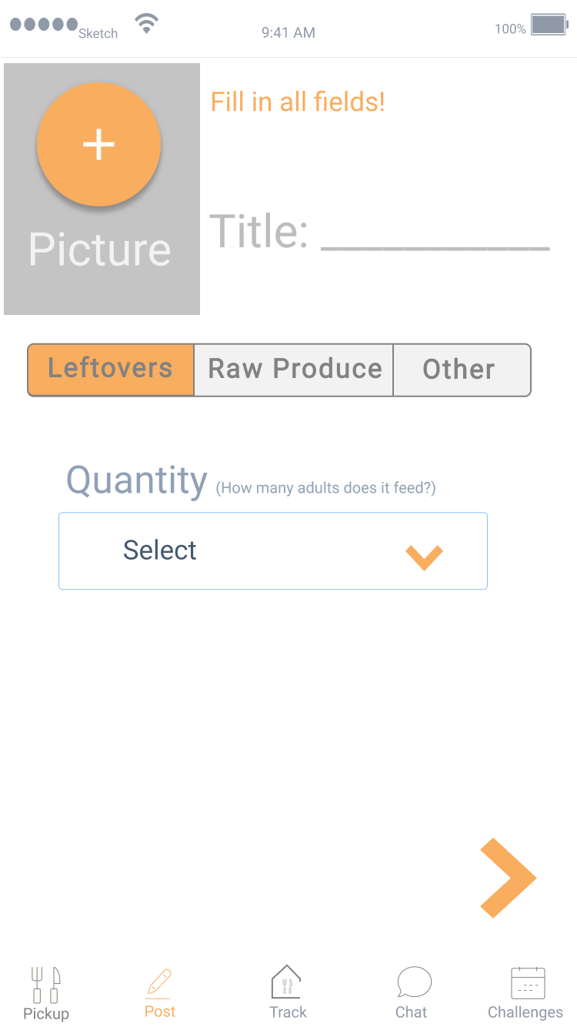
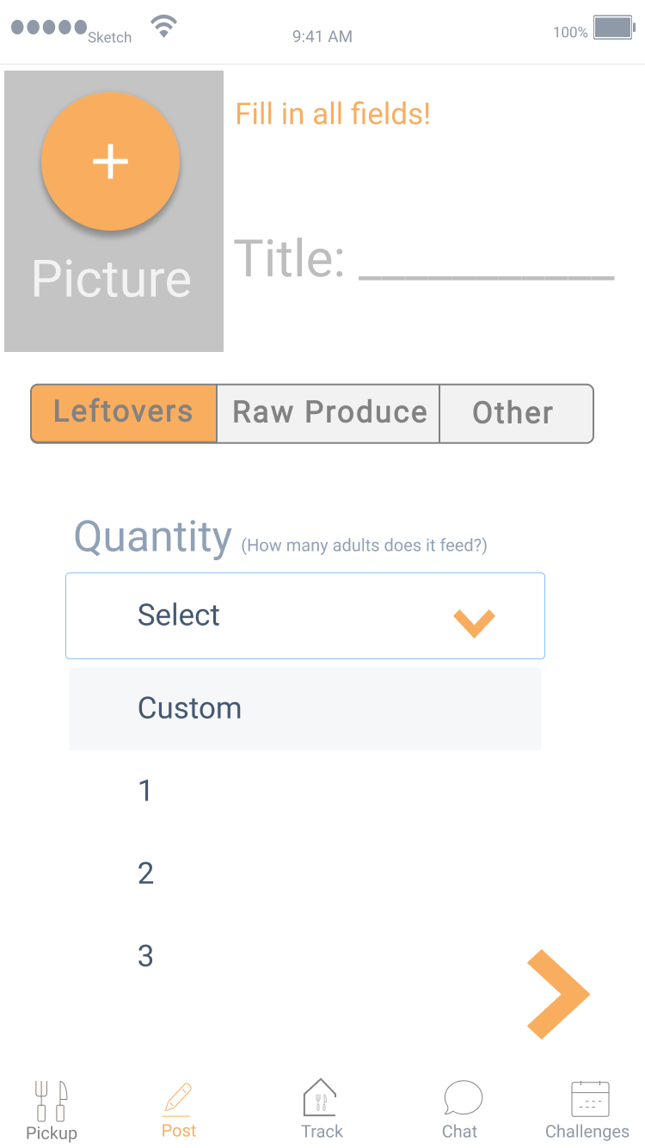
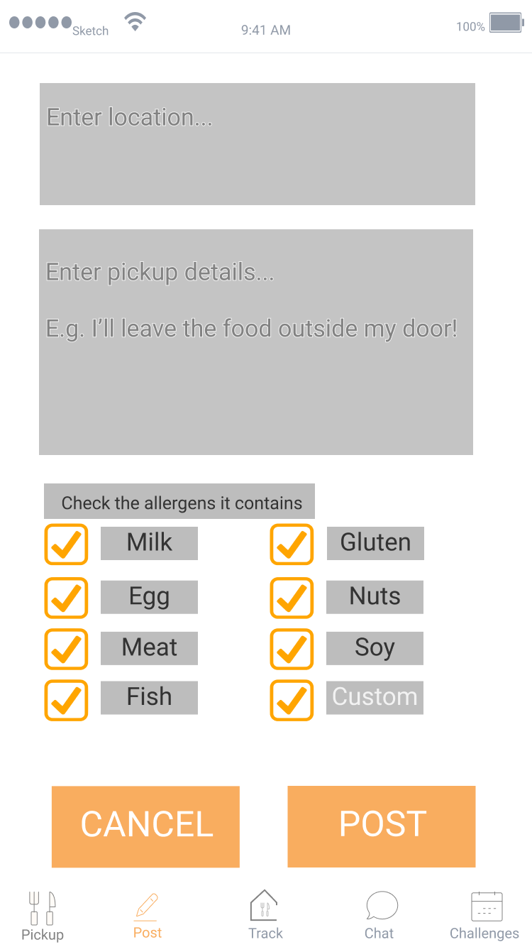
Task 1: Post Leftover Food
Notes:
The tabs at the bottom are present throughout the app. Will show two slides per task.

Slide 20
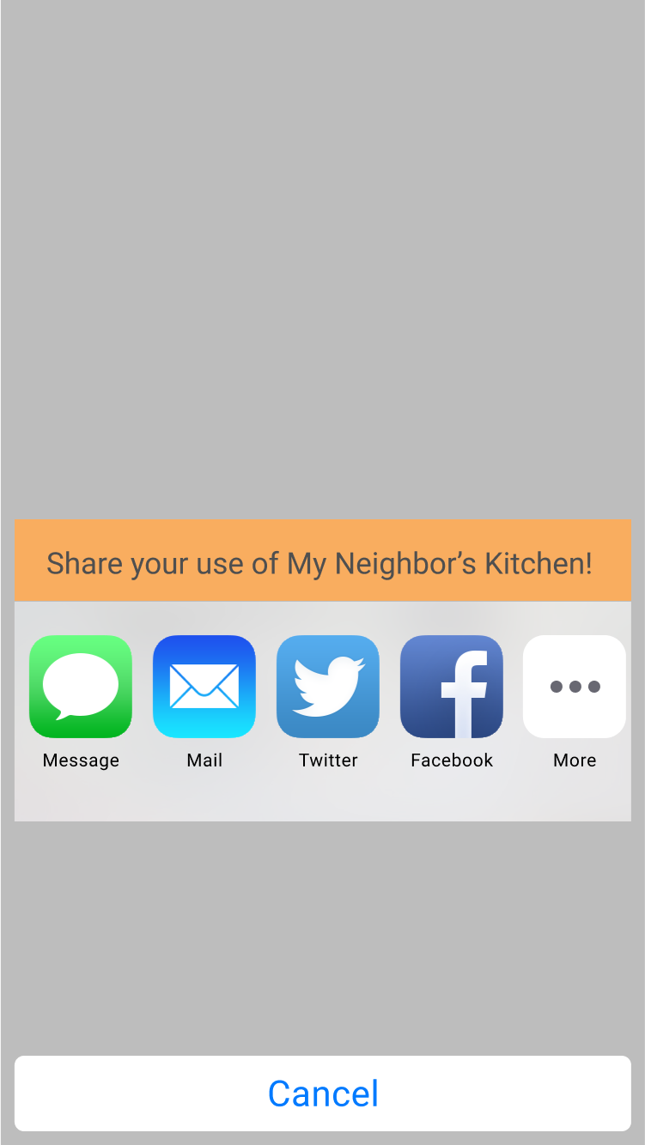
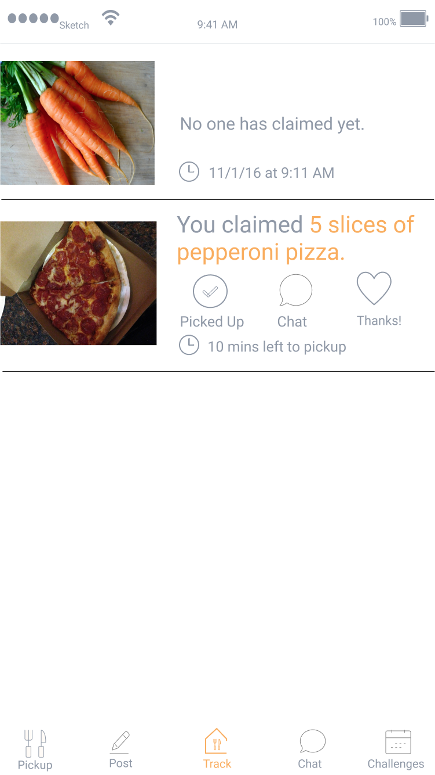
Task 1: Post Leftover Food

Slide 21
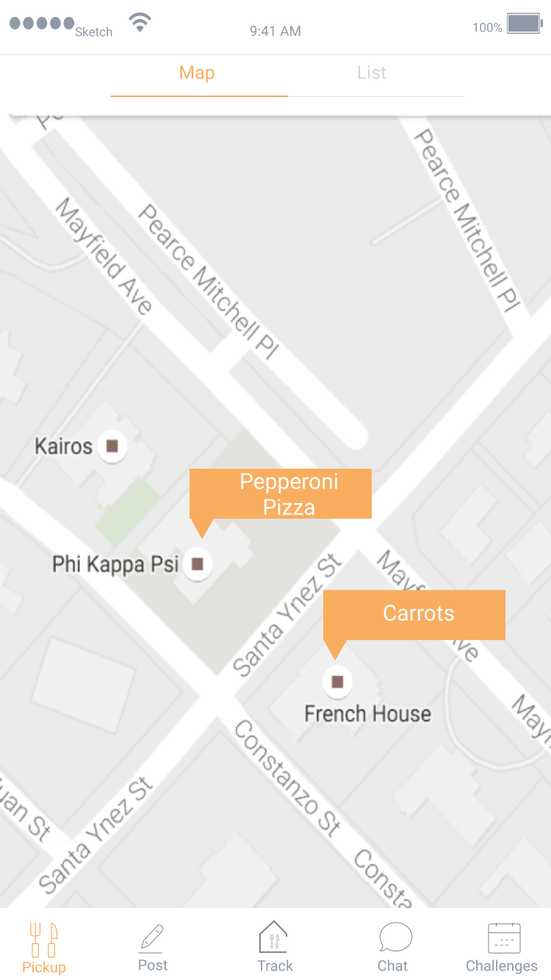
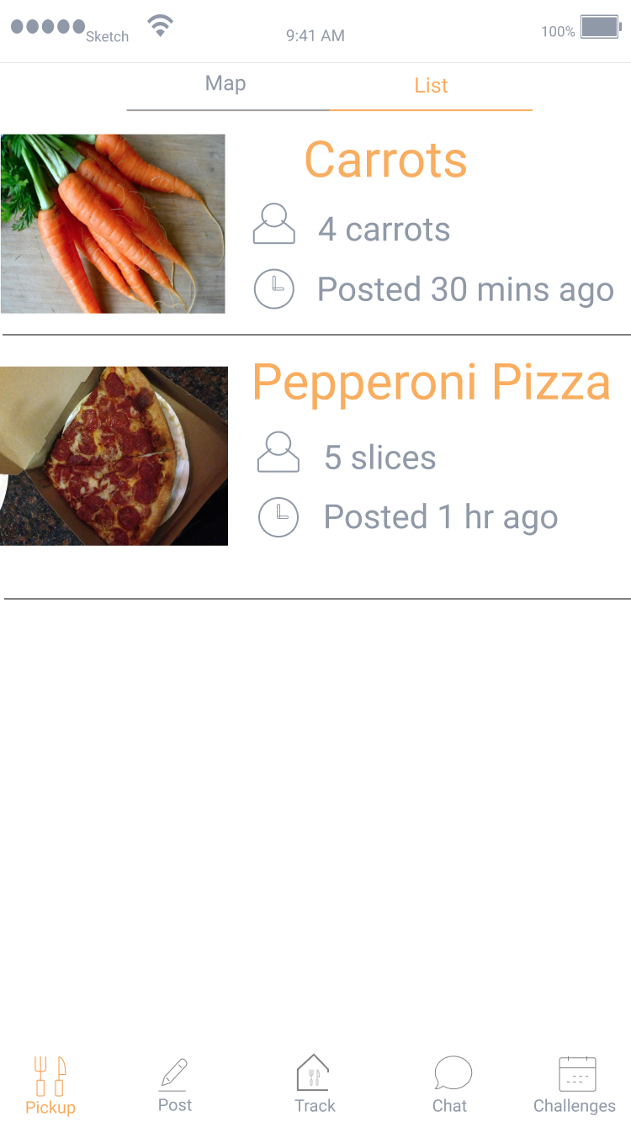
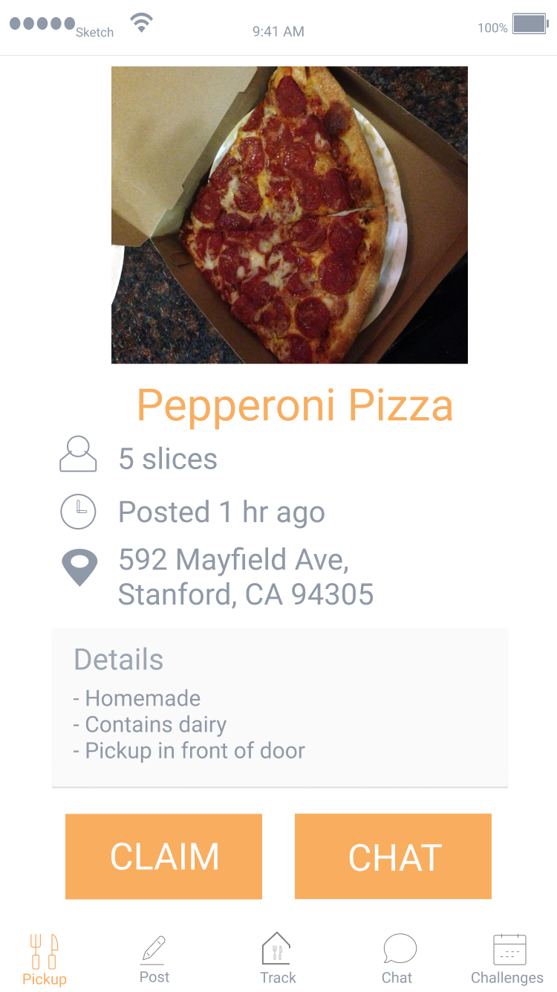
Task 2: Pickup Leftover Food
Notes:
The tabs at the bottom are present throughout the app

Slide 22
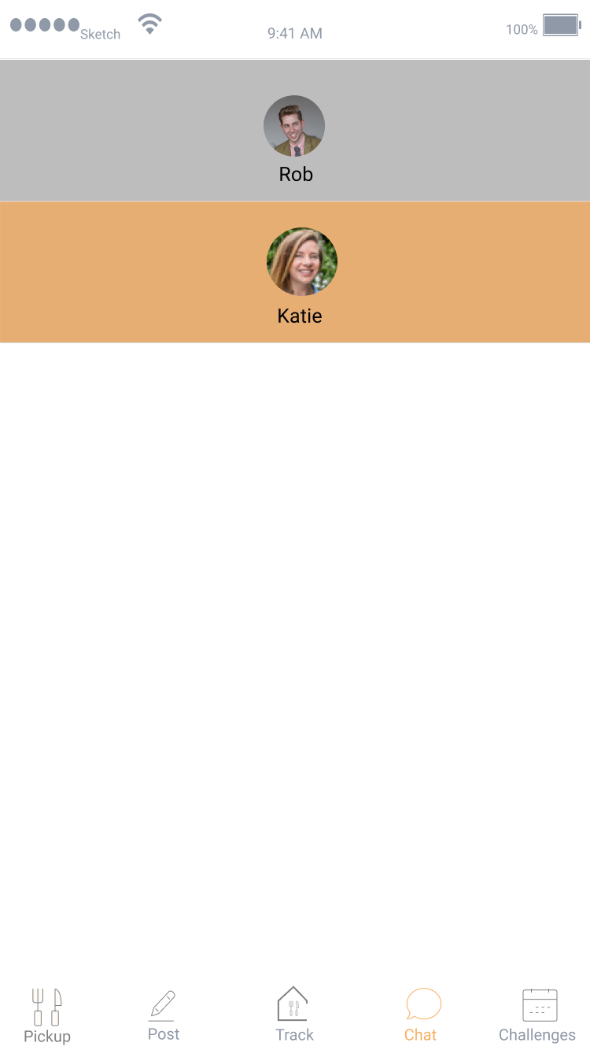
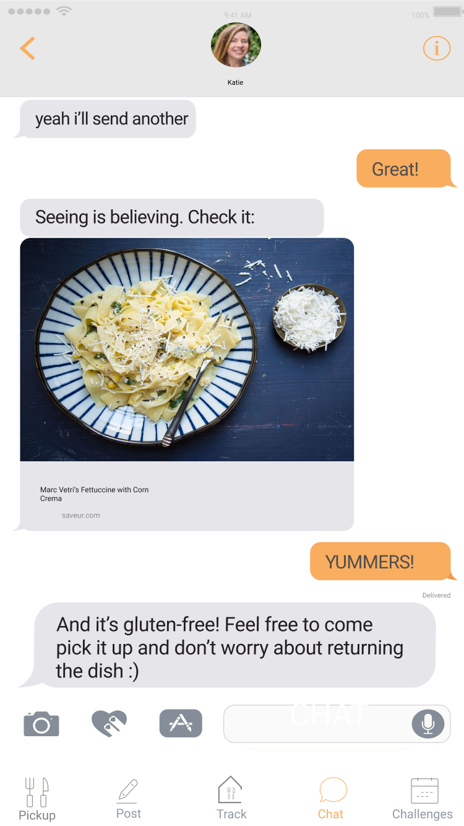
Task 2: Pickup Leftover Food
Claim → Track
Chat

Slide 23
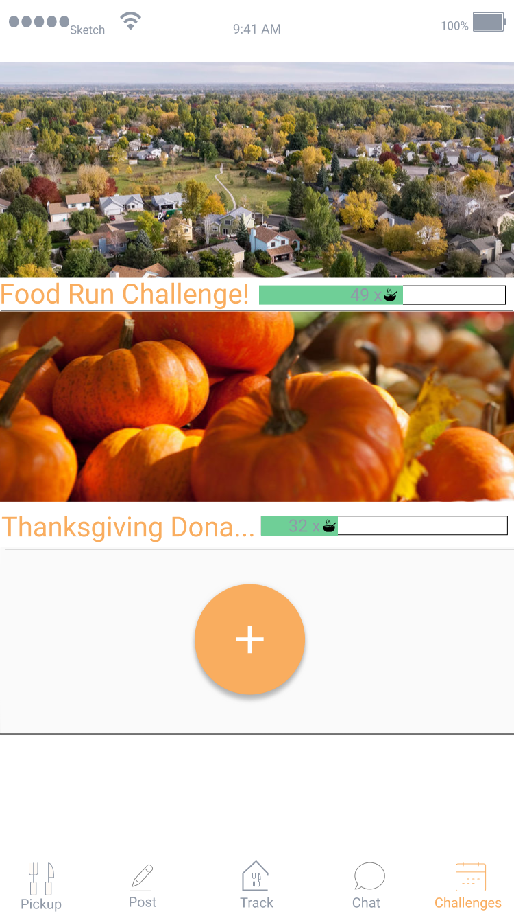
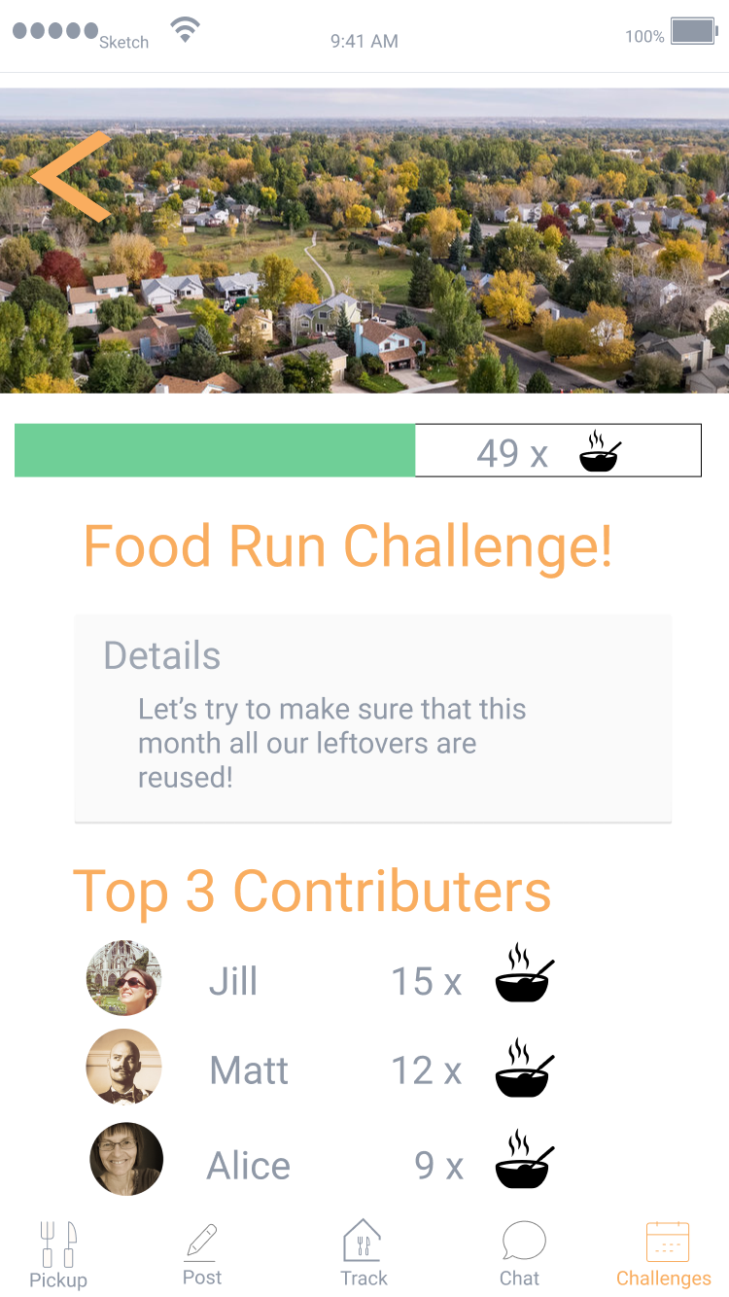
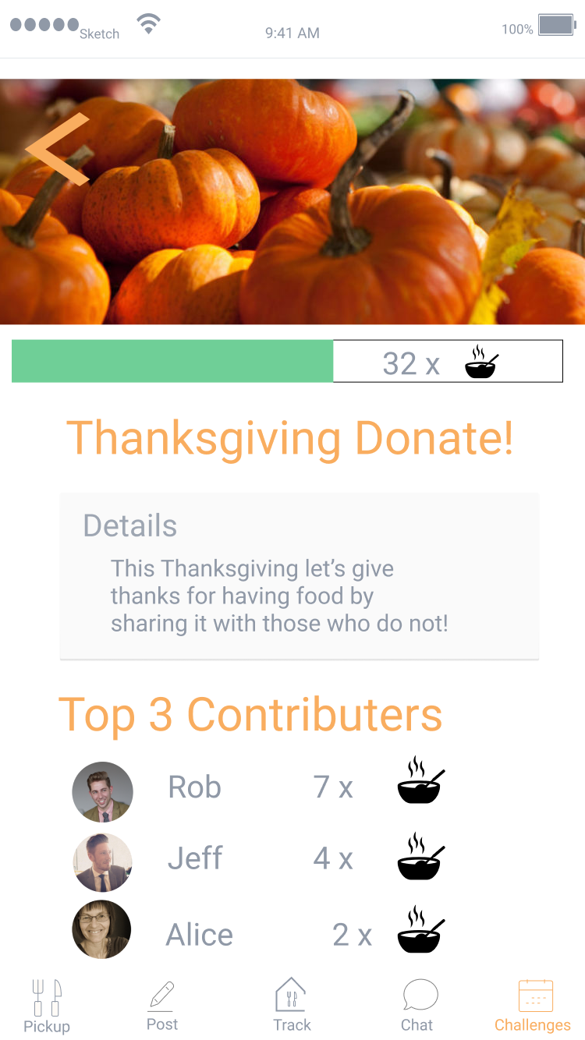
Task 3: Start a Community Challenge
Notes:
The tabs at the bottom are present throughout the app

Slide 24
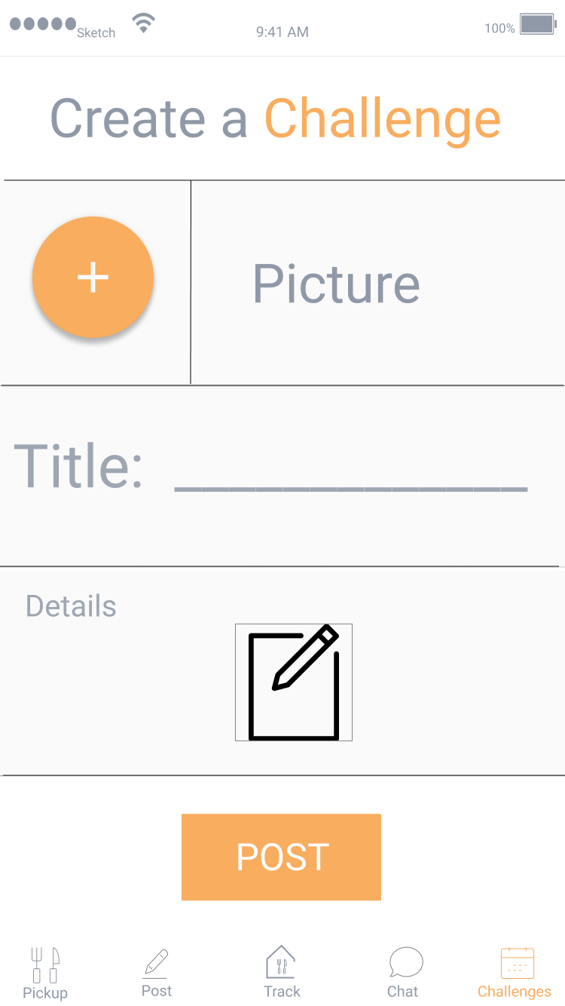
Task 3: Start a Community Challenge
Notes:
The tabs at the bottom are present throughout the app

Slide 25
Outline
Tasks
Revised Design
Major Changes
New Task Flows
Prototype Overview
Notes:
Walkthrough of major changes in the UI for each task

Slide 26
Prototype Overview: Tools, Limitations, and Tradeoffs
Tools:
Figma, Sketch Templates, Marvel
Pros:
Figma allows web-based real time collaboration
Figma is integrated with Sketch
Sketch templates replicate familiar iPhone design
Easy to code screen flow in Marvel
Can open Marvel as an app on iPhone
Cons:
Steep learning curve
Not much documentation for Figma
Back & forth sketch modification & animation between Figma and Marvel
No sense of state in Marvel

Slide 27
Prototype Overview: Tools, Limitations, and Tradeoffs
Limitations
No indications that you can post to your chosen social circle
Currently no personal statistics or profile editing features - not needed for core tasks
Notification settings haven’t yet been implemented
Maps aren’t zoomable

Slide 28
Prototype Overview: Tools, Limitations, and Tradeoffs
All data is hard-coded - users cannot actually enter input
Artificial initial state required for pickup task
Generation of food details page and challenge page from the text entry is Wizard-of-Oz’d
Requires backend work

Slide 29
Questions + Comments?

